Slide 1

“A startup with 20 plus years of experience”

Slide 2

Our Mission
We are a group of Healthcare Professionals gathered under the umbrella of Med AMS. Our mission is to market and promote medical products and projects in the MENA region where we have been operating for many years now each one in his field of expertise
We add value by eliminating the technical, cultural, and linguistic barriers thus conveying the information quickly and precisely.
Our expertise in this field helped us build a very strong and reliable network of partners who can help us market and promote Medical Products in all specialties

Slide 3
Location
Beirut Office
Med AMS Ltd.
Samra Center – Ground Floor
Fanar – Beirut – Lebanon
P.O.Box: 90815
Larnaca Office
Med AMS Ltd.
Agion Panton 17c
Aradippou, Larnaca, Cyprus
P.O.Box: 7101

Slide 4
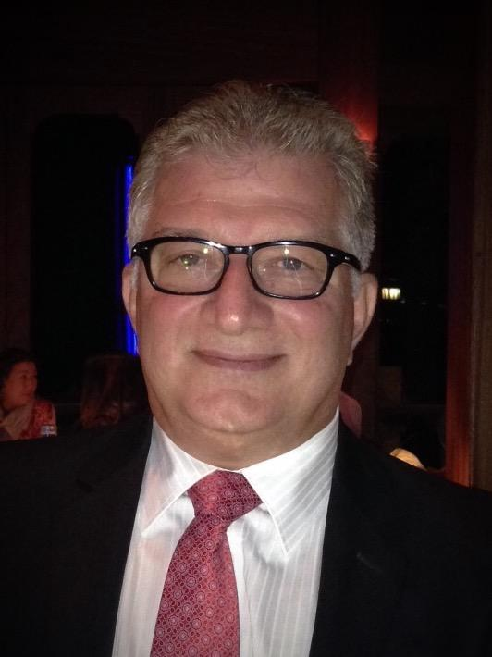
Medical Advisor
Dr. Wael Lakkis is a BSc, MD and Obs-Gyn residency graduate of the American University of Beirut (AUB). He underwent three years of rigorous training in an accredited advanced pelvic surgery program at McGill University, Montreal Canada as well as Saint Raphael Hospital affiliate of Yale University, New Haven, CT, USA.
Dr. Lakkis acquired unique diagnostic skills and specialized surgical techniques in extensive oncologic pelvic surgery, urogynecology surgery for the treatment of urinary stress incontinence, pelvic floor repair, and advanced minimally invasive endoscopic surgery.
Dr. Lakkis is licensed in the states of New York and Connecticut and served as an assistant professor at New York Medical College for ten years where he received several teaching and recognition awards including the Golden Apple Award for the best teacher of New York City.

Slide 5
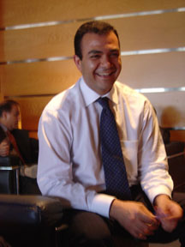
General Manager
Mr. Amine Samra is an MS, Computer Sciences graduate of the Lebanese American University of Beirut (LAU). He is also a holder of an MBA from ESA – ESCP – EAP, Paris.
Mr. Samra acquired huge skills in Healthcare Facilities by being member of a Hospital Administration in Beirut for 17 years.
Mr. Samra worked as a country manager for Orthopaedic Solutions at Dima Healthcare representing Smith & Nephew, Medartis, Panmed, Life Spine. He also worked in the distribution of many brands in the MENA region with Dima Healthcare.
Mr. Samra was lately appointed Regional Business Development Manager at Fattal Group for Orthopaedic and Special Projects, before deciding to start our own business.

Slide 6
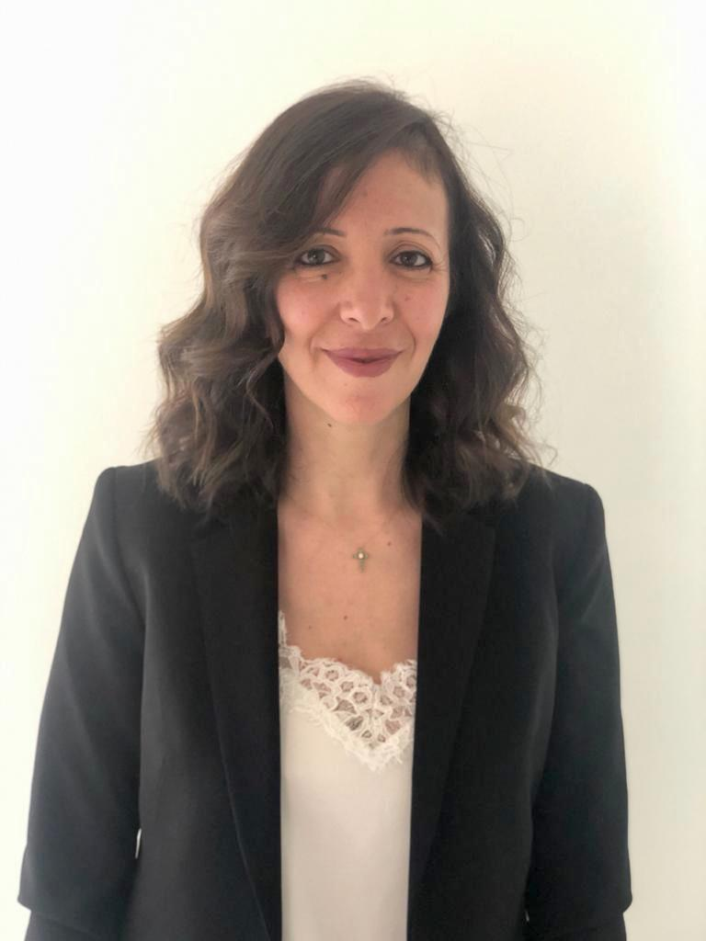
Business & Market Development Manager
Ms. Laurence Kiwan is an MS, Chemistry graduate of the Lebanese University in Beirut . She is also a holder of an EMBA Executif Master of Business Administration from ESA Ecole Superieure Des Affaires– ESCP – EAP, Beirut-Paris
Ms Kiwan worked as an experienced Business Unit Manager for Hospital Medical Supplies & Capital Equipment at Droguerie De L’Union with a demonstrated history of working in the hospital/medical and healthcare industry, developing long term partnerships with customers providing quality solutions and services, building strong relationships with Suppliers ensuring that customer focus and patient care are priorities
She was able to manage seven therapeutic areas/services targeting Hospitals, private clinics and pharmacies; with a main aim to align with shared departments in order to complete the full process from Suppliers, legal aspects, inventory analysis, risk assessments to reach the customer needs by offering ethical, transparent and sustainable services through leading Suppliers BBRAUN, GE Healthcare, Ulrich, 3M, Convatec, Aesculap

Slide 7
Channel Manager
Mr. Moeen Ud-Din Chishti is an MS, in Botany & International Relation . He is also a holder of an MBA in Marketing
Mr. Chishti with 20+ years sales/marketing Experience, worked as a Senior Area Manager, Business Development Country Manager, Franchise Manager & General Manager with a demonstrated history of working in the healthcare industry, for Medical Devices, in Afghanistan & Pakistan
He was regularly working with EMEA-APAC Team to develop the Strategies, Operation excellence and channel management with proven Sales management experience. Developed and Coached team of talented people in different assignments and executed Marketing campaigns & initiatives Such as CME’s Activities, Hands on Workshops and Seminars and was exposed to well-rounded opportunity of establishing market access models, sales force, and commercial excellence systems, managing high performance team securing sales growth.
He Handled business development and portfolio management assignments. Worked with cross functional team involving HR, Finance, operations, legal and regulatory, assigning distribution network development, new products launches, Territory enhancement through leading Suppliers Becton Dickinson BD (MedSurgical/Diagnostic portfolio), Covidien, Medtronic, Thermo-Fisher Scientific & ASTO Life Science (authorized business partner for Becton Dickinson USA)

Slide 8
Market Coverage
Lebanon
Saudi Arabia
Kuwait
UAE
Jordan
Syria
Qatar Cyprus Libya
Bahrain Greece Afghanistan
Oman Turkey Pakistan
Yemen Tunisia
Egypt Morocco

Slide 9
Services
Market Assessment MENA & North Africa region
Identifying territory needs of cutting-edge and innovative products/solutions
Creating long term partnerships with Suppliers
Setting up jointly with SUPPLIER marketing strategies/market development
Continuous Field sales visits in the territory
Advising on shipping products and credit collection
Product training sessions and seminars; educational activities & workshops
Assistance in Regulatory Affairs
Projects Implementation

Slide 10
Services
Dialysis Center of Excellence set up complete project & medical management in Cyprus:
Infrastructure
Implementation of standard operating procedures
Medical Equipment purchase
Recruitment of needed resources
Operations & Management of the Center
Expertise in set up IVF Center Of Excellence, Catheterization Labs, Open Heart & Chemotherapy Units
Turnkey projects with medical consultancy : Hospitals, stand-alone centers,…

Slide 11
Therapeutic lines coverage
Esthetic
Fillers
Medical Diagnostics
Contrast Media
Sports Medicine Orthopedic
RFID Tags solutions
Infection Control & Sterilization
Surgery

Slide 12




Brands – Partnership
EBERLE GmbH & Co. KG manufactures medical devices for minimally invasive surgery and orthopedics
Pioneer in the health IT, Medication
Management and pharmacy automation
REJOIN provides specialized sports medicine & minimally invasive orthopedic solutions for global healthcare professionals
Treatment cosmetics infused with vitamins, antioxidants and natural minerals and oils
Refineé Age Reversing Skin Care uses the most exceptional quality natural botanical extracts from plants and sea life

